Slide 1
Introduction to LDAP 2018
Frank A. Kuse

Slide 2
Introduction to LDAP
AGENDA
Understanding LDAP
LDAP Servers
Information Structure
Protocol Overview
LDAP operations

Slide 3
UNDERSTANDING LDAP
LDAP stands for Lightweight Directory Access Protocol.
It is an internet protocol for accessing distributed directory services.
It uses the TCP/IP protocols for its operations
It also forms the standard for allowing directories to be managed.

Slide 4
LDAP Servers
OpenLDAP
Active directory
Apache Directory Server
FreeIPA
OpenDS
Novell eDirectory
Sun Java System Directory Server
IBM Tivoli Directory Server

Slide 5
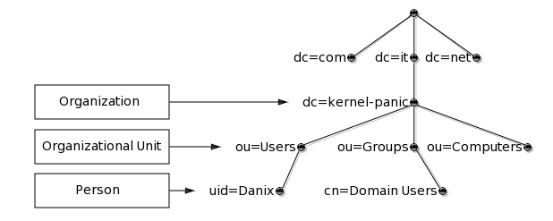
Information Structure
It has a DIT ( Directory Information Tree) which help present information in the hierarchical tree format
Example of a DIT is as below.

Slide 6
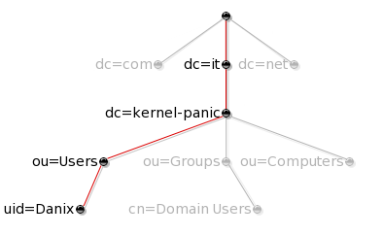
Information Structure (Cont)
Each node in the LDAP tree is called an entry and is uniquely identified by its Distinguished Name (DN)
For instance, the DN of the entry highlighted in the following picture below.

Slide 7
Information Structure (Cont)
The DN for the above tree can then be written as below
“ui=Danix,ou=Users,dc=kernel-panic,dc=it” See RFC4514 for full description of the DN format.
An entry consists of a set of attributes, each attribute has a name or type and one or more values.
“dc” stands for Domain Component
“cn” stands for Common Name
Objectclasses define the attribute structure of an LDAP entry.
Both ObjectClasses and Attributes are defined within schemas

Slide 8
Information Structure (Cont)
O stands for organization
OU stands for Organizational unit
SN stands for Surname
Givenname stands for First Name
UID stands for Userid
Mail stands for Email address
C stands for country
L stands for location
St stands for Status

Slide 9
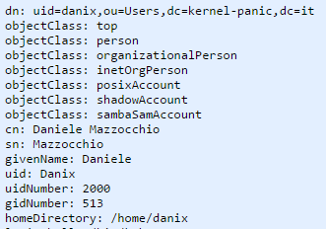
Information Structure (Cont)
Entries can be represented in a human-readable format by using the LDIF format as in example below.

Slide 10
Protocol Overview
Client starts an LDAP session by connecting to an LDAP Server
The default TCP port is 389
Bind to the server through an authentication process
Client then sends an operation request to the server
The Server sends responses in return

Slide 11
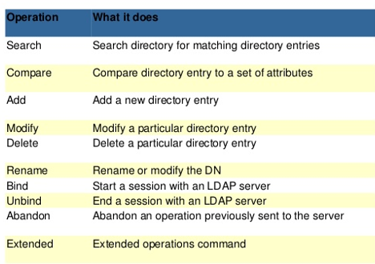
LDAP Operations

Slide 12
LDAP Operation (Cont)
Some useful LDAP operation commands are as below.
Ldapadd
Ldapsearch
Some useful link to see example of such operation are below
http://www.kernel-panic.it/openbsd/pdc/pdc2.html
http://www.my-tiny.net/Lab06_WebLDAP.htm
http://himanshu.gilani.info/blog/2013/01/12/introduction-to-ldap/

